Slide 1





MARKETPLACE FOR NORTHWEST One place to buy and sell
Sec 03 TEAM03
DR. CHANDRA MOULI KOTTETI – Client/Mentor
Sajida MOHAMMAD – Backend developer
HARI KIRAN ALURI – Front End Developer
KIRAN KUMAR GUNDAPUNENI – Backend developer
USHA PATI – Tester/QA

Slide 2





Team Members
2
DR.CHANDRA MOULI
KOTTETI
SAJIDA MOHAMMAD
USHA PATI
HARI KIRAN ALURI
KIRAN KUMAR GUNDAPUNENI

Slide 3

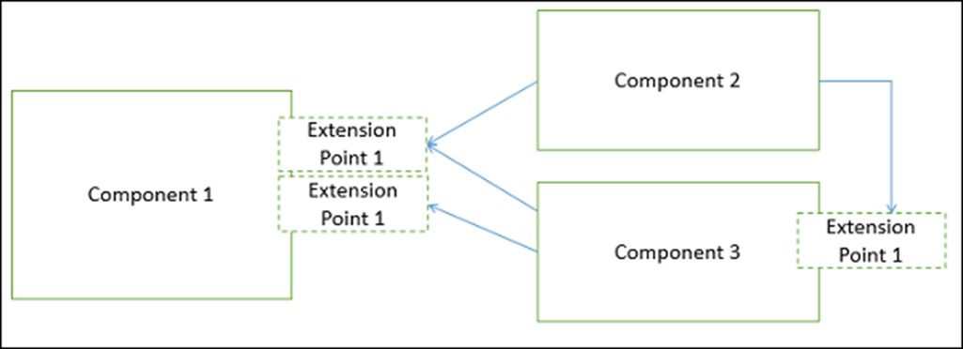
CBA(Component Based Architecture)
3
Ensures component reusability
Component - reusable set of well-defined functionality
CBA is used in React, Vue
Fig 1.1 – CB Architecture
s
Presented By Sajida Mohammad

Slide 4
Components
4
THEMES – SERIES OF STYLES
WIDGETS – BLOCKS OF UI
LIBRARIES – Ex: JAVASCRIPT LIBRARIES
PLUGIN – ADD-ONS THAT ARE INSTALLED ON A PROGRAM

Slide 5
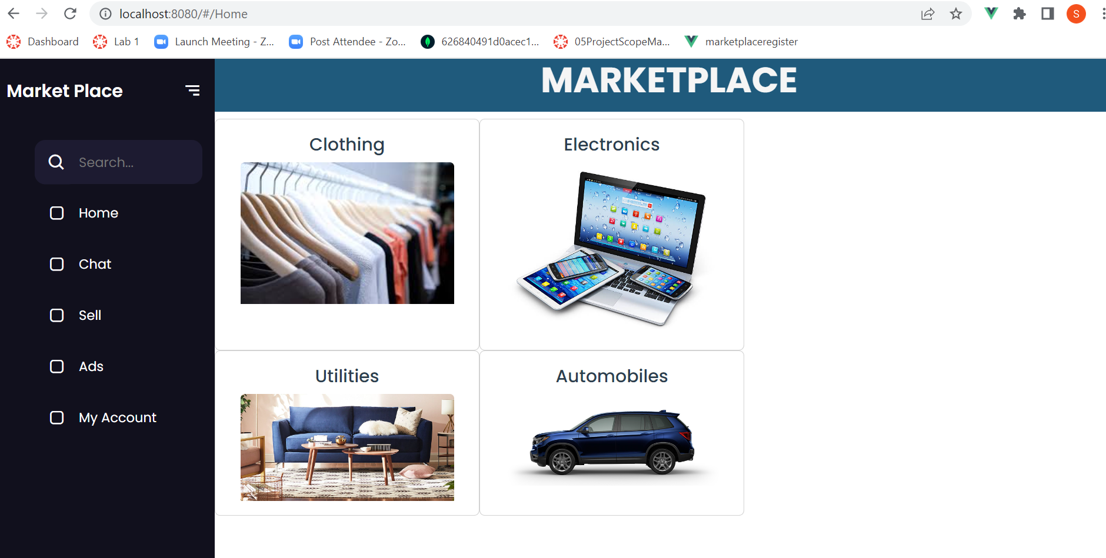
Example
5
Fig 1.2 - Home page

Slide 6
Advantages
6
More control
Lower costs
Faster Development
Takes Advantage of Specialized skills

Slide 7
forms in Angular
7
Handling user input with forms is the cornerstone of many common applications. Applications use forms to enable users to log in, to update a profile
Angular provides two different approaches to handling user input through forms: reactive and template-driven
Reactive forms : Provide direct, explicit access to the underlying form's object model. Compared to template-driven forms, they are more robust: they're more scalable, reusable, and testable.
Template-driven forms : rely on directives in the template to create and manipulate the underlying object model. They are useful for adding a simple form to an app, such as an email list signup form.
Presented By Hari Kiran Aluri

Slide 8
Built-in attribute directives
8
Ng Class : Adds and removes a set of CSS classes.
Ng Style: Adds and removes a set of HTML styles.
Ng Model : Adds two-way data binding to an HTML form element.
Presented By Hari Kiran Aluri

Slide 9
Templates, directives, and data binding
9
A template combines HTML with Angular markup that can modify HTML elements before they are displayed.
Event binding : Lets your application respond to user input in the target environment by updating your application data
Property binding: Lets you interpolate values that are computed from your application data into the HTML

Slide 10
Spring Boot
10
In Spring boot, we can add dependencies and store the artifacts in the remote repository
Artifact is either produced or used by a project
GroupID is a universally unique identifier for a project
Dependency is a typical java project that relies on libraries to build or run
These dependencies are inside maven

Slide 11
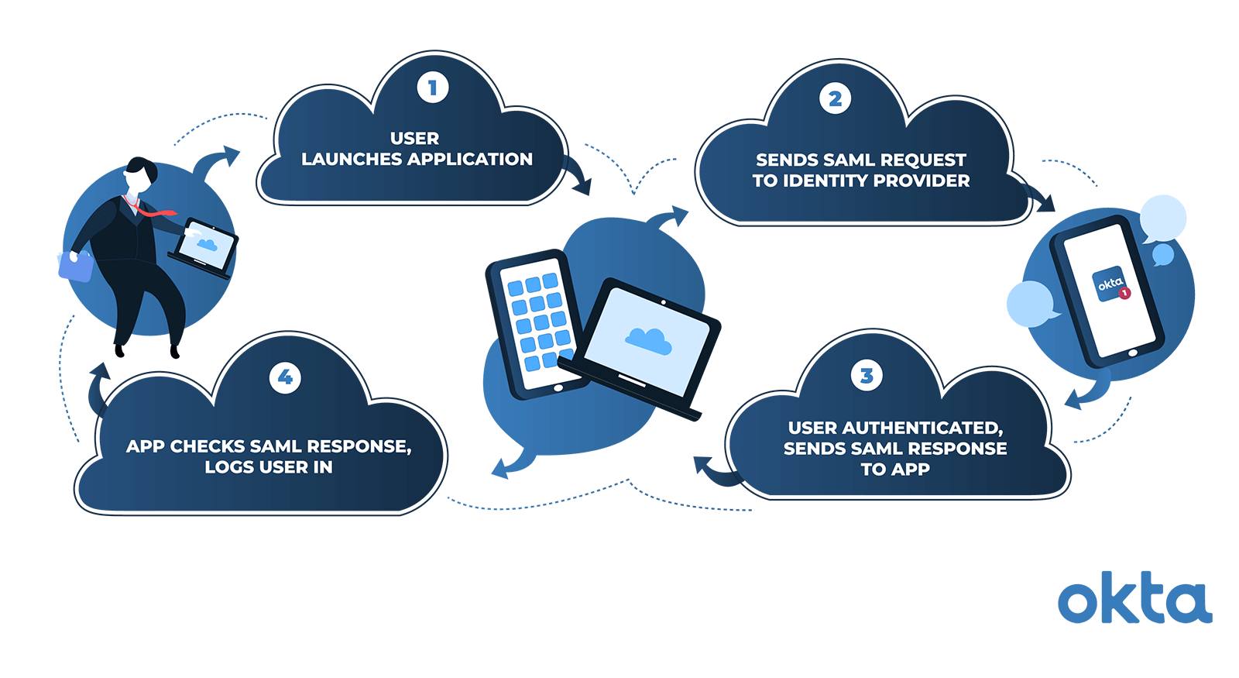
OAuth vs SAML
11
Two different types of Authentication
OAuth & SAML
SAML follows Authentication
OAuth follows Authorization
Fig 2.1 – SAML Workflow
s

Slide 12
Build Tools
12
Build tools are programs that automate the creation of the executable applications from source code
Building incorporates compiling, linking and packaging the code into a usable or executable form
Basically, build automation is the act of scripting or automating a wide variety of tasks that software developers do in their day-to-day activities

Slide 13
Maven
13
A comprehensive maintainable, reusable, and simple model for projects (POM) Project Object Model
Automatic parent versioning
Ensures consistent usage across all projects
It’s extensible and you can easily write plugins using scripting languages or java

Slide 14
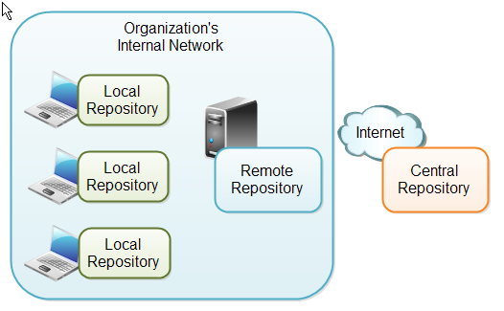
Maven Repositories
14
Fig 2.2 – Maven repo

Slide 15
Selenium
15
What is selenium?
Selenium is a free (open-source) automated testing framework used to validate web applications across different browsers and platforms
Requirements:
Java software
Browser
IDE Ensures component reusability
Ensures component reusability

Slide 16
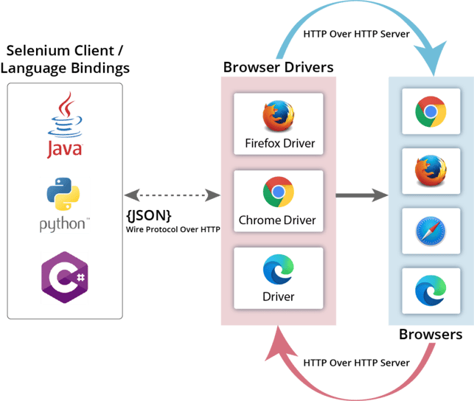
Selenium Architecture
16
FIG 4.1 Architecture of selenium

Slide 17
Selenium Frameworks
17
1. Linear Scripting Framework
2. Modular Testing Framework
3. Library Architecture Testing/ Functional Decomposition Framework
4. Data-driven Framework
5. Keyword Driven Testing Framework
6. Hybrid Driven Testing Framework
7. Behavior Driven Development Testing Framework
Presented By Usha Pati

Slide 18
Pros and Cons of Selenium Testing
18
Pros:
Open-Source testing tool
Provides high tester flexibility
Supports test case execution on multiple operating systems
Test cases can be executed while the browser window is minimized
Supports parallel test execution
Cons:
Tests only web applications
This Cannot access the web elements outside the web applications that are under test
No guaranteed user support is available. We have to depend on customer communities
Does not support image testing. It must be integrated with Sikuli for image testing

Slide 19
Summary
19
Component Based Architecture and its advantages
Authentication in Spring boot
Build Tools
Attribute directives in Angular
Selenium and its requirements
Architecture and Frameworks of Selenium
Pros and Cons of Selenium Testing

Slide 20
Lessons Learnt
20
Storing all the product details in a single table
Issues with storing data in remote data base
Storing of password filed in database
Converting the images into bytes and storing in database
Learnt Webpages testing Using Selenium
Presented By the Team

Slide 21

21

Slide 22
Team Members
22
DR.CHANDRA MOULI
KOTTETI
SAJIDA MOHAMMAD
USHA PATI
HARI KIRAN ALURI
KIRAN KUMAR GUNDAPUNENI

